Slide 4
XXX XXXXX XXX XXXXXXXXXXXX

Slide 5
XXX XXXXX XXX XXXXXXXXXXXX
XX
XXX
XXX
XXX
XXX
XX
XXX
XXX
XXX
XXX
XXX
XXX
XXX
XX
XXX
XXX
XXX
XXX
XXX
XXX
XXX
XXX
XX
XXX
XXX
XX
XX
XXX
XX
XXX
XXX
XXX
XXX
XXX
XXX
XXX
XXX
XXX
XXX
XXX
XXX
XXX
XXX
XXX
XXX
XXX
XXX
XXX
XX
XXX
XXX
XXX
XXX
XXX
XXX
XXX
XXX
XXX
XX
XXX
XXX XXXXXXXXXX
XXXXX
XXXXXXXXX XXXXX XXXXXX
XXXXXXXXXX XXXXXX XXXX
XXX
XXXX
XXXX
XXX
XXXX
XXXX
XXXX
XXXX
XXXX
XXXX
XXXX
XXX
XXXX
XXXX
XXXX
XXXX
XXXX
XXXX
XXXX
XXXX
XXX
XXXX
XXXX
XXXX
XXXX
XXX
XXXX
XXXX
XXXX
XXX
XXXX
XXXX
XXXX
XXXX
XXXX
XXXX
XXXX
XXXX
XXXX
XXXX
XXXX
XXXX
XXX
XXXX
XXXX
XXXX
XXX
XXXX
XXX
XXXX
XXXX
XXXX
XXXX
XXXX

Slide 6
XXXX
XXX
XXXX
XXXX
XXXX
XXXX
XXX
XXXX
XXXX
XXXX
XXXX
XXX
XXXX
XXXX
XXXX
XXXX
XXXX
XXXX
XXXX
XXXX
XXXX
XXX
XXXX
XXXX
XXX
XXXX
XXXX
XXXX
XXXX
XXXX
XXX
XXXX
XXXX
XXXX
XXXX
XXX
XXXX
XXXX
XXXX
XXXX
XXXX
XXXX
XXXX
XXX
XXXX
XXXX
XXXX
XXXX
XXXX
XXX
XXXX
XXXX
XXXX
XXXX
XXXX
XXXX
XXXX
XXXX
XXXX
XXXX
XXX XXXXXXXXXX
XXX
XXX
XXX
XXX
XXX
XXX
XXX
XXX
XX
XXX
XXX
XXX
XXX
XXX
XXX
XXX
XXX
XXX
XXX
XXX
XXX
XXX
XX
XX
XX
XXX
XXX
XXX
XXX
XXX
XXX
XXX
XXX
XXX
XXX
XX
XXX
XX
XXX
XXX
XXX
XXX
XXX
XXX
XXX
XXX
XXX
XXX
XXX
XX
XXX
XX
XX
XXX
XXX
XXX
XXX
XXX
XXX
XXX

Slide 7
XXX XXXXXXXXXX
XXXX XXX XXXX X XXXXXX X XXXX XX XXXXXXX XX XXXXXX XX XXXXX XXXXXXXXXX XXX XXXXXXXXXXXX
XXXXXXX XXXXX X XXXX XXXX XX XXXXX XXX XXXXXXXXXX XXX XXX XXXXXX XX XXXXXXXXXX
XXXXXXXXX X XXXX XX XXXXXXXXX XXXXXX XX XXXXXX XXXX XX XXXXXX XX XX XXXXXXXXX XXXXX XXXX XXXXXX XX XXXXX XX XXXXXX XXXXXXX

Slide 8
XXXXXXXX XXXXXXX XXXXXXXXXX
XXX XXX XXXXXXXXX XXXXXX XX XX XXXXXXXX XXXX XX XX XXXXXXXX XXXXXXXXX
X XXX XXXX XXXX XX XXXXXXX XXX XXX XXXXXXXXX XX XXXXXX XX XXXXXXXX XXX XXXXXXXXXX XXX XXXXXXXXX
XXXXXXXXXXXX XXX XXXXXXXXX XXXXXXX XXXX X XXXXXXXX XXXXXX XXXXXXXXXX XXX XXX XXXXXXX XXX XXXX XX XX XXXXXXXX XXXXXXXX XXXXXXXXX XXXXXXX

Slide 9
XXX XXXXXXX
XX XXXXXXXX XXXX XXX XXXXXXXXX XXX XXXXXXX XXXXX XXX XXXXXXXX XXXXXX
XX XXXXXXXXXXX XXXX XXXXXXXXXX XXXX XXXX XXXXXXXXXXX XXXXXXXXXX XXX XXXXXX XX XXX XXXXXXX
XX XXXXXXXXXXX XXX XX XXXXXXXX XXX XXXX X XXX XXXXXXXXXX
XX XXXX XXXXXXXXXX XX XXX XXXXXXXXXXXX XX XXX XXXXXXXXXXX
XX XXXXXXXXXXX XXX XXXXXXX XXX XXXXXXXXX XXX XXXXXXXX XX XXXXXXX XXXXXXXXXXXXXXXX
XX XXXXXXXXXXX XXXXXXXXXX XXXX XXXXXX XX XXXXXX XXXXXXXXXXXX
XX XXXXXXXXX XXX XXXXXXXX XXX XXXXXX XX XXXXXXX XXX XXXXXXX

Slide 10
XXX XXXXXXX
XX XXXXXXXXXXXXXXXX
XX XXXXXXXXXXXXXXXXX
XX XXXXXXXXXXXXX
XX XXXXXXXXXXXXXXXXXXXXXXX
XX XXXXXXXXXXXXX
XX XXXXXX XXXXXXXXXXXXXX
XX XXXXXXXXXXXXXX

Slide 11
XXX XXXXXXX
XX XXXXXXXXXXXXXXXX
XX XXXXXXXXXXXXXXXXX
XX XXXXXXXXXXXXX
XX XXXXXXXXXXXXXXXXXXXXXXX
XX XXXXXXXXXXXXX
XX XXXXXX XXXXXXXXXXXXXX
XX XXXXXXXXXXXXXX

Slide 12
XXX XXXXXXXXXXX

Slide 13
XXXXX XXXXXXXXXX
XXXXXXXXXX XXXX XX XXX XXX X XXXXXXX XXX XX XXXXXX XXX XXXXXXX XX XXXXX XXXXXXXXXXX XXXX XXXXXX XX XX XXX XXXX XXXXXXXX XXXX XXX XXXXX XXXXXXXXXX XXXXXXXXX XX XXXX XXXXXX XX X XXXXXXXX XXXXXXX
XXXXXX XXXXX XXXXXX X XXXXXXX XXXXXXX XXXXXX XXXX XXX XX XXXX XXXXXXXX XX XXX XXXX XXXXXXXXXXX X XXXXX XX XXXXX XXXX
XX XX XXXXXXXXXX XXXXXXXXXXXXX

Slide 14
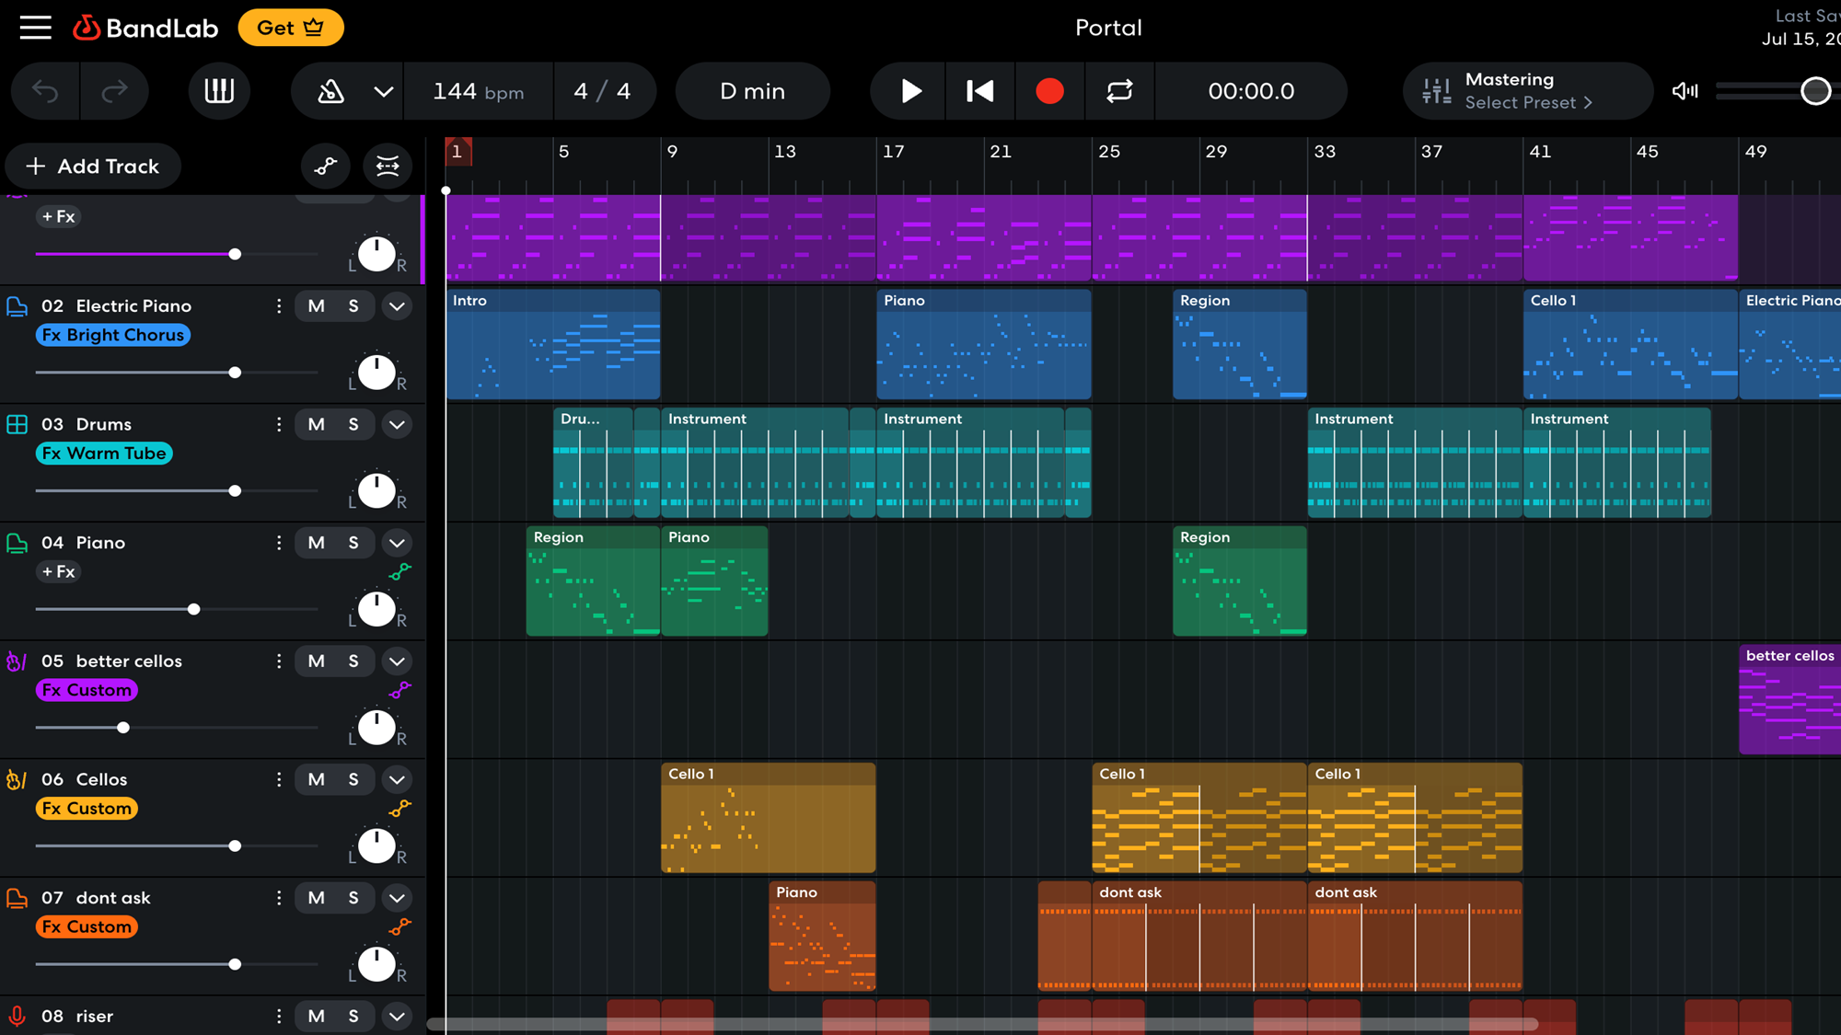
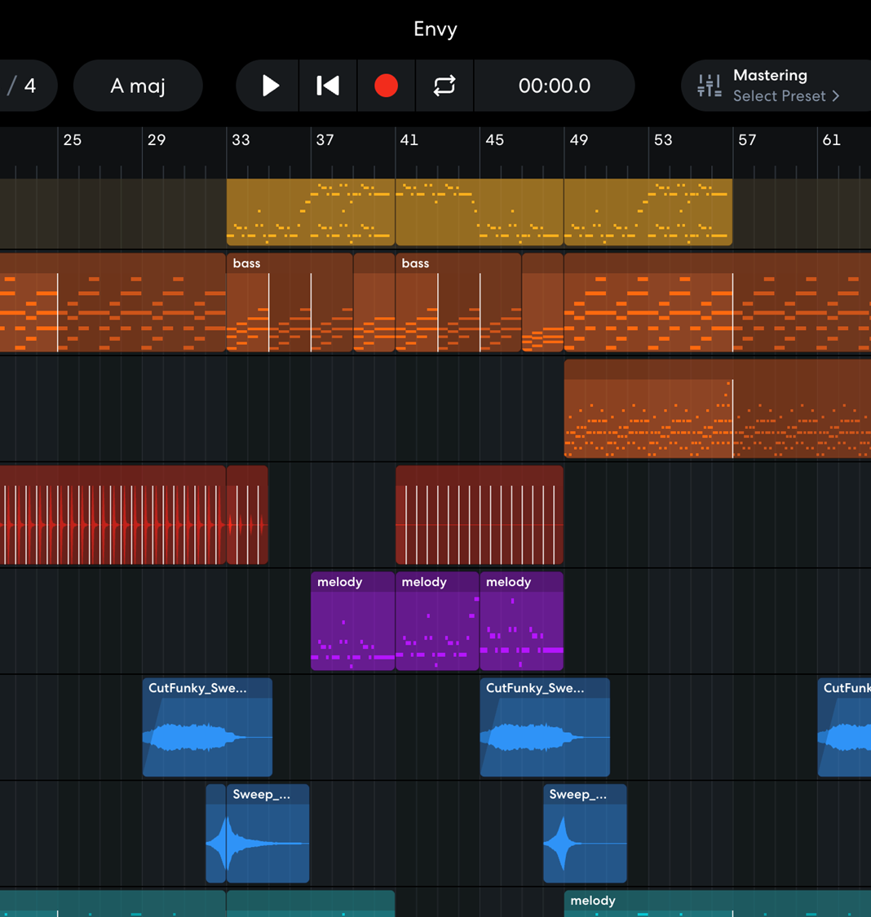
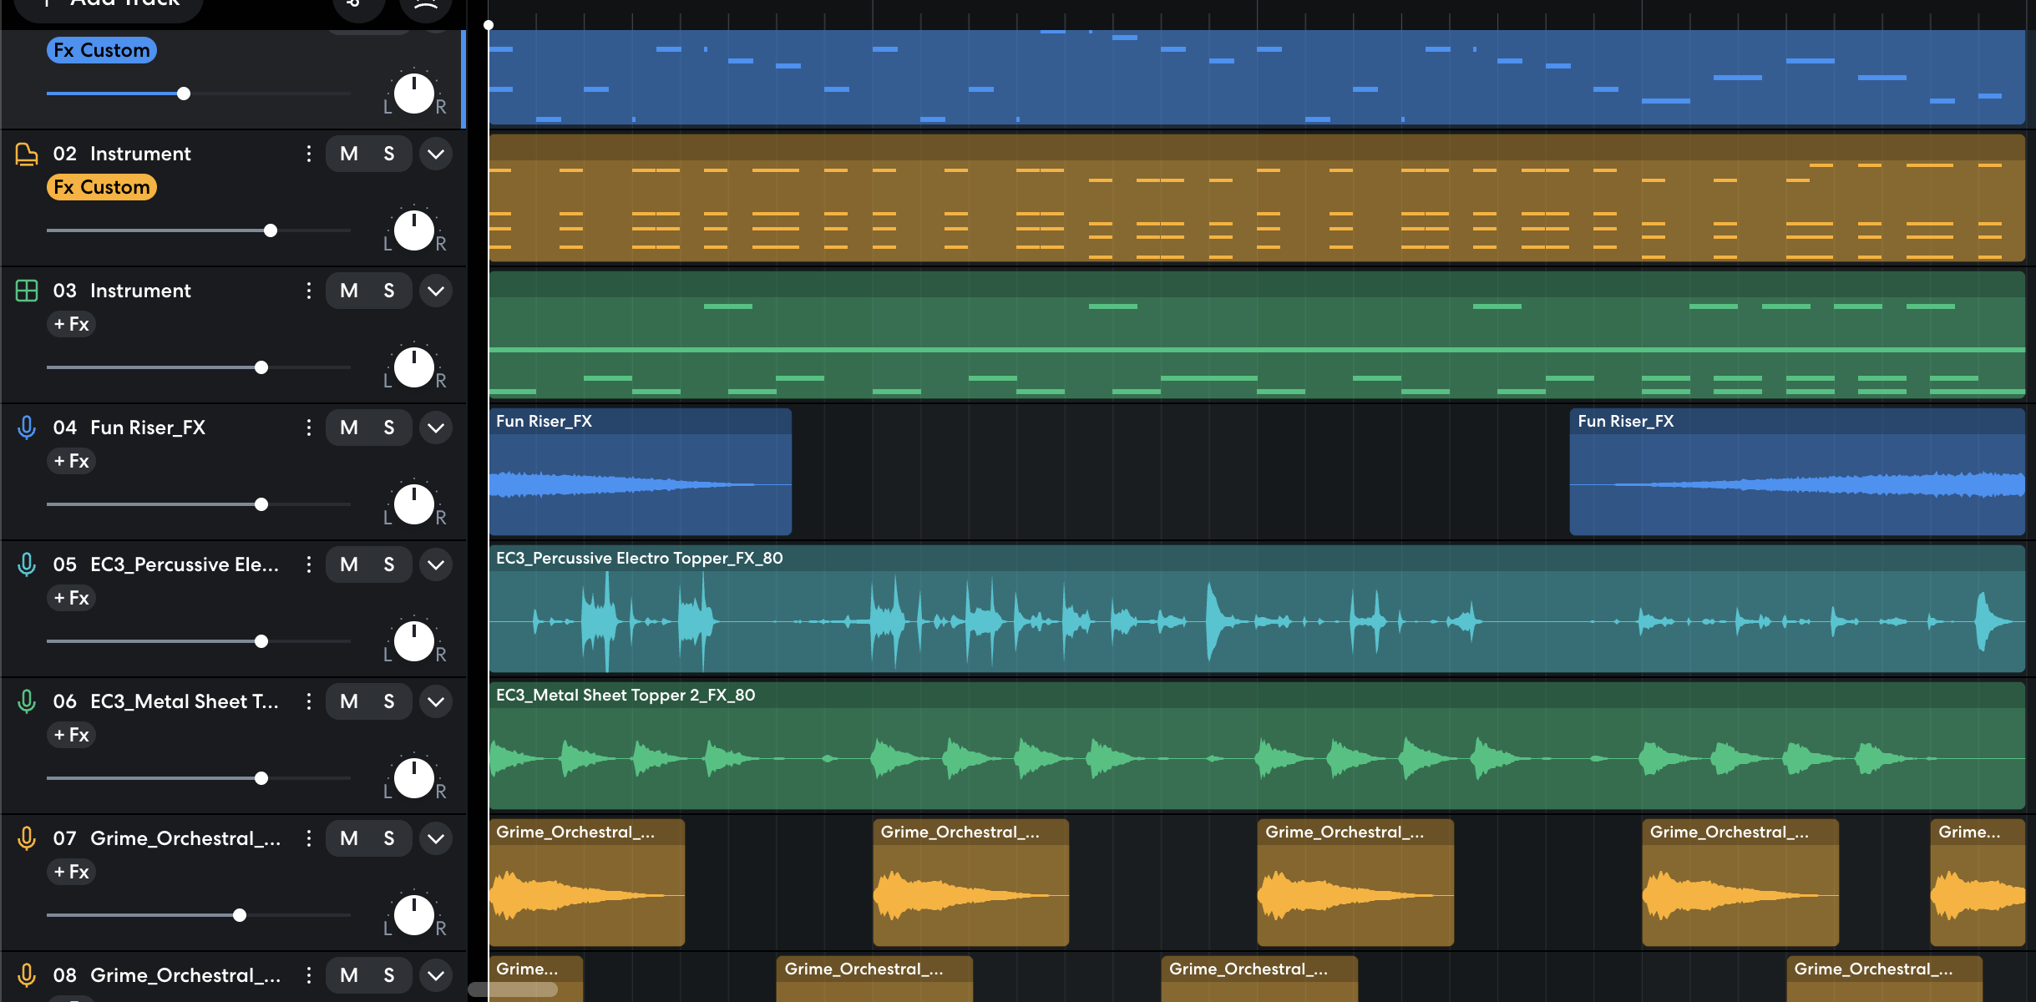

Slide 15
XXXXXXXX XXX XXXXXXXXXX XXX XXXXX
XXXXX XXXXXXX XX X XXXXXXXX XXX XXXXXXX XXXXXX X XXXXX X XXXXX XXXXXXX XXX XXXX XXXXX XX XX XXXXXXX XX XXX XXXX XXXXX XXXXXXXXXXXX XXXXXXXXXX XXXX XXX X XXXXXXX X XXX XX XXX X XXXXX X XXX XXX XX XXXXXX X XXXXXXXXX XXXXX XXXXX XXXXX XXXXXXX X XXXXX XXXX XXXXXXXX XX XX XXXXXXXX XXXXX XXXXX X XXX XXX XX XXXXX XXX X XXX XXXX XXXXXXXXXXXX XX XXX XXXXX XXX XXXXXX XXXXXXXXXX XXXXX XXXXXX XX XXXXXX XXXXXX XXXXXXXXX
XX XX XXXXXXXXXXXXXXXX
XX XX XXXXXXXXXXXXXXXXX
XX XX XXXXXXXXXXXXXXXXXXXXXXX

Slide 17
XXXXXXXX X XXXXX XXXXXXXXXX
XXXXX XX X XXXX XXXXXX XXXX XXXX XXXXXXXXX X XXXXXXXX XXXXXXX XX XXXXXXX X XXXX XXXXX XXXX X XXXXXXXXXXXXX XXXX XXXXXX XXXXXXX X XXXXXXXXX XX XXXX XXX X XXX XXXXXXXXXXX
XX XX XXXXXXXXXXXXXXXXXXXX XX XXXXXXXXXXXXXXXXXXXX XX XXXXXXXXXXXXXXXXXXXXXXX
Notes:
ahem Unity…
On another note, this was the easiest on to gather reflections on, as I consistently logged my progress and planning throughout — it was digital, so it made stuff easier

Slide 18
Notes:
Passing slide to fix shape bug

Slide 19
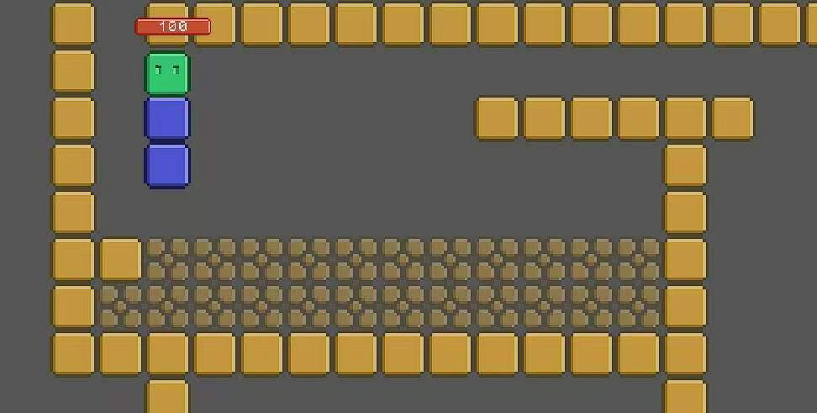
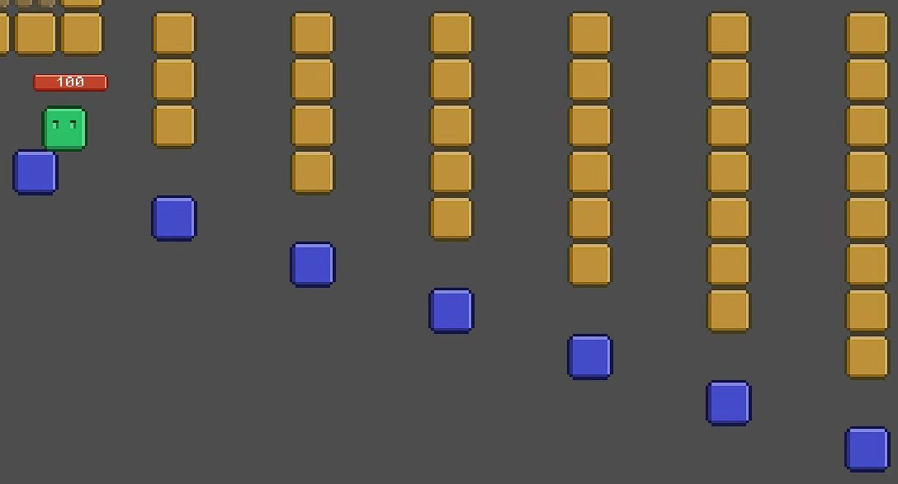
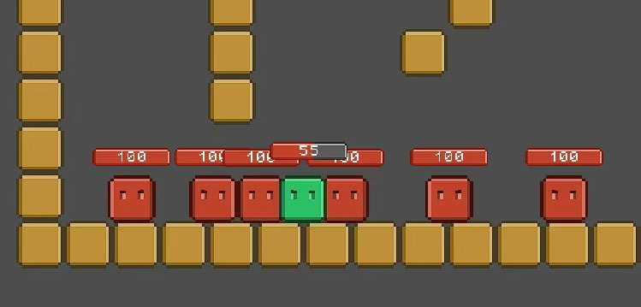
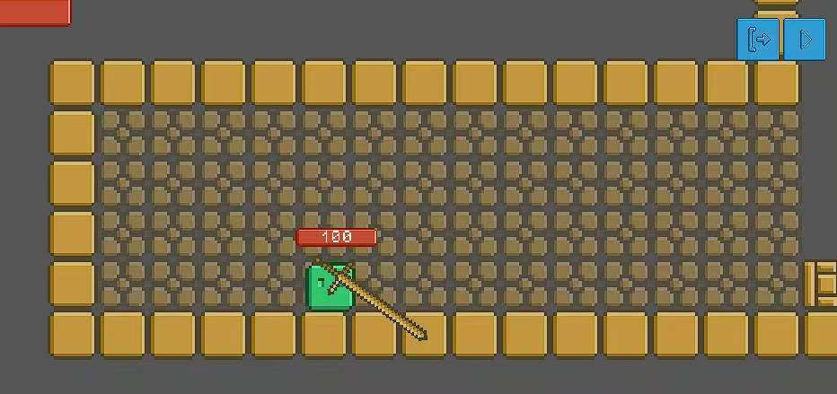
Notes:
ahem Unity…
On another note, this was the easiest on to gather reflections on, as I consistently logged my progress and planning throughout — it was digital, so it made stuff easier
1. Identify your own strengths and develop areas for personal growth
2. Demonstrate that challenges have been undertaken, developing new skills in the process
3. Demonstrate how to initiate and plan a CAS experience
4. Show commitment to and perseverance in CAS experiences
5. Demonstrate the s​kills and recognize the benefits of working collaborative​ly
6. Demonstrate engagement with issues of global significance
7. Recognize and consider the ethics of choices and actions

Slide 20
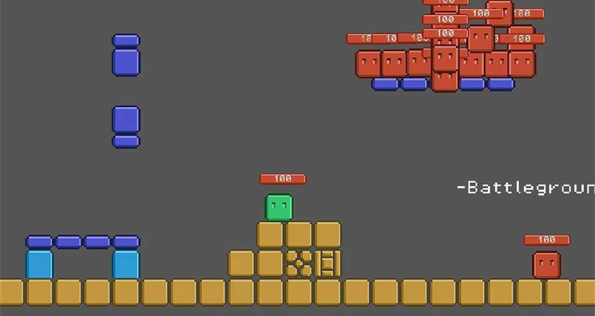
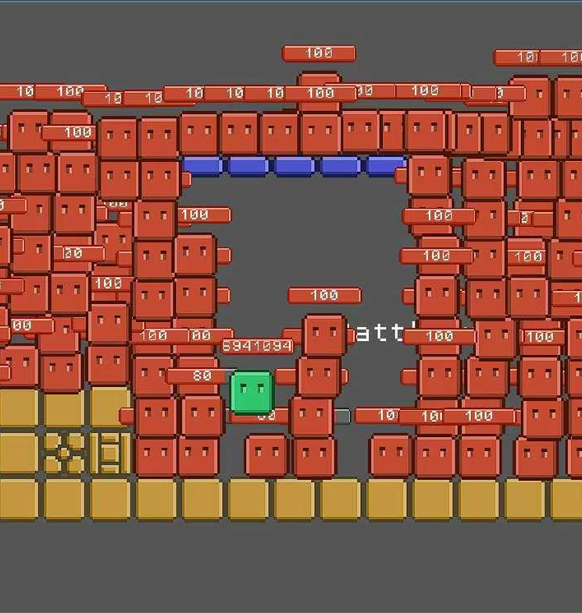
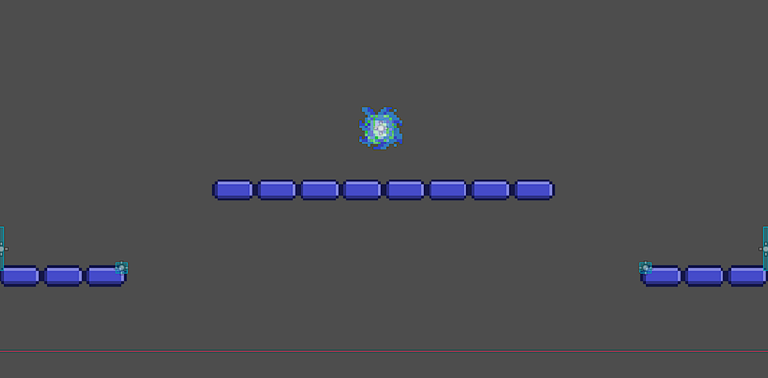
Notes:
ahem Unity…
On another note, this was the easiest on to gather reflections on, as I consistently logged my progress and planning throughout — it was digital, so it made stuff easier
1. Identify your own strengths and develop areas for personal growth
2. Demonstrate that challenges have been undertaken, developing new skills in the process
3. Demonstrate how to initiate and plan a CAS experience
4. Show commitment to and perseverance in CAS experiences
5. Demonstrate the s​kills and recognize the benefits of working collaborative​ly
6. Demonstrate engagement with issues of global significance
7. Recognize and consider the ethics of choices and actions

Slide 21
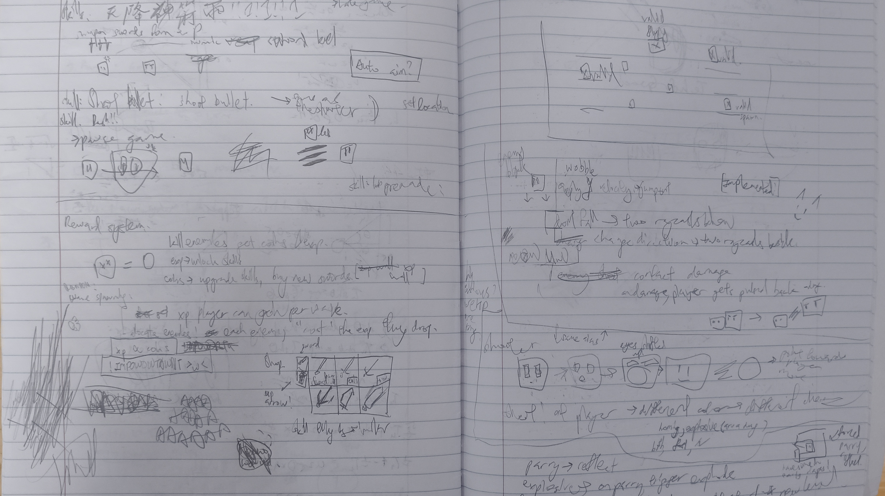

Slide 22
XXXX
XXXX
XXX XXXXX XXXXXXXX XX XXXXXXXXXX
X
XXXXXX
XXXX XX XXXXXX XXXXX XXX XXXXXXXXXXXXX XX X XXXXXXXXX XXXXXXXX XXXXXXXX XX XXXX XXXXXXXXXX XXXXXX XXXXXXXXX XXXXXXXXX XXXXX XXXXX XXXXXX XXXXXXXXXXX XXXX XXXXXXX XXXX XXXXXXXXXXX X XXXX XXXXXXX XXX XXX XXXXXXXXX XXXXXXX XXXXXXX XXXX XXX XXXXXXXXXXXXXXXXXX XXXXXXXX X XXXXXXXXX XX XXXXXXXXXX XXXXX
XXXXX
X
X
XX XX XXXXXXXXXXXXXXXXXXXX XX XXXXXXXXXXXXXXXXXXXX XX XXXXXXXXXXXXXXXXXXXXXXX
XXXXXX
XXXXX

Slide 23
XXXXX XXXXXXXX
X
X
X
X
XXXX
XXXX
X
X
X
XXXXXX
XXXXXX
X
X
X
X
X
XXXXX
X
XXXXX
X
X

Slide 24
X
XXXX
XXXX
XXXXXX
XXXXXX XXXX
X
XX XXXXXX
X
X
XXXX XX
X
X
XXXX XXX
X
X
XXXX XX XXX
X
X
XXXXXX XXX
X
X
XXXX XXX
X
XXXXXX
X
X
XXXXX
XXXXX

Slide 25



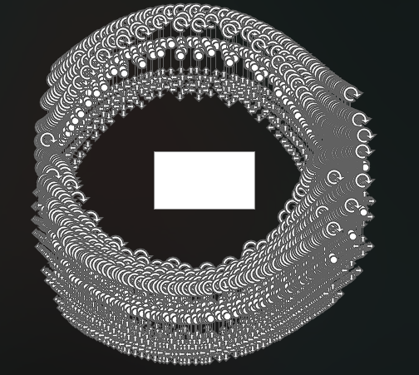
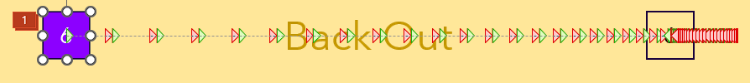



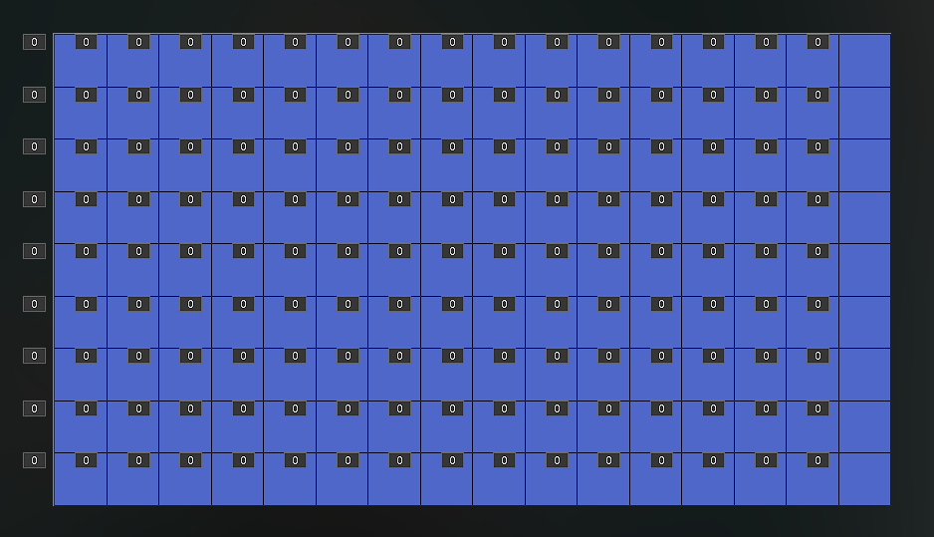

X
X
X
X
X
X
X
X
X
X
X
X
X

Slide 27



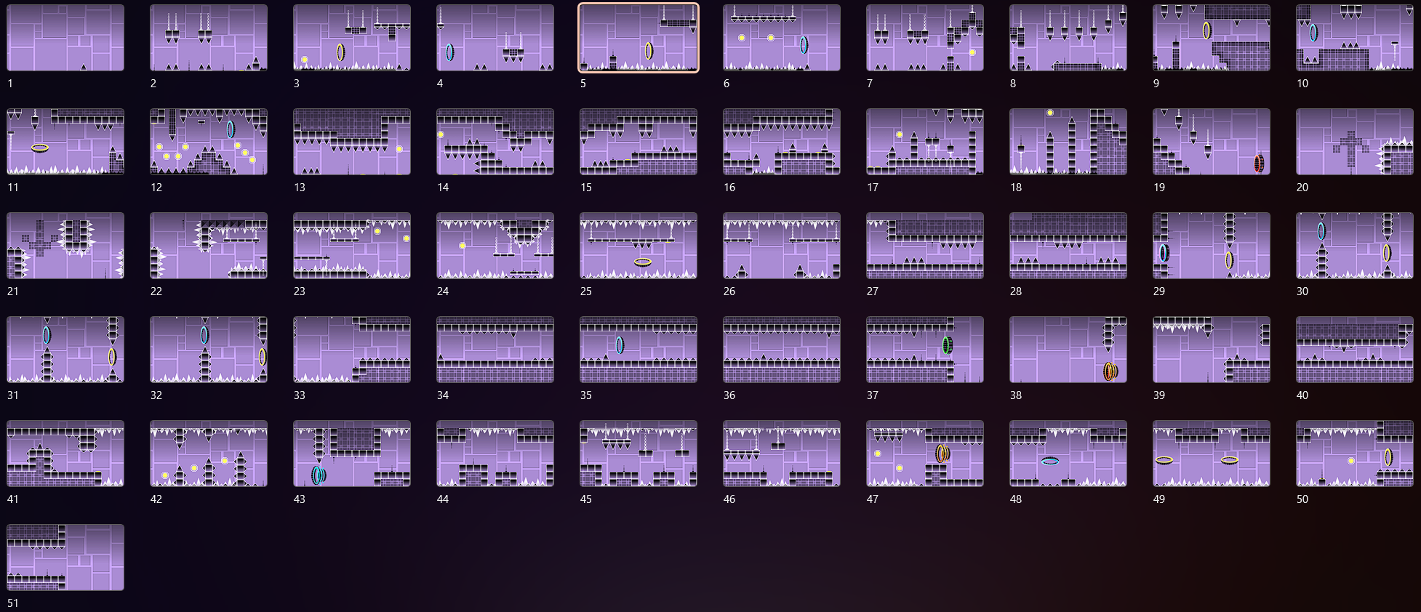

Slide 28
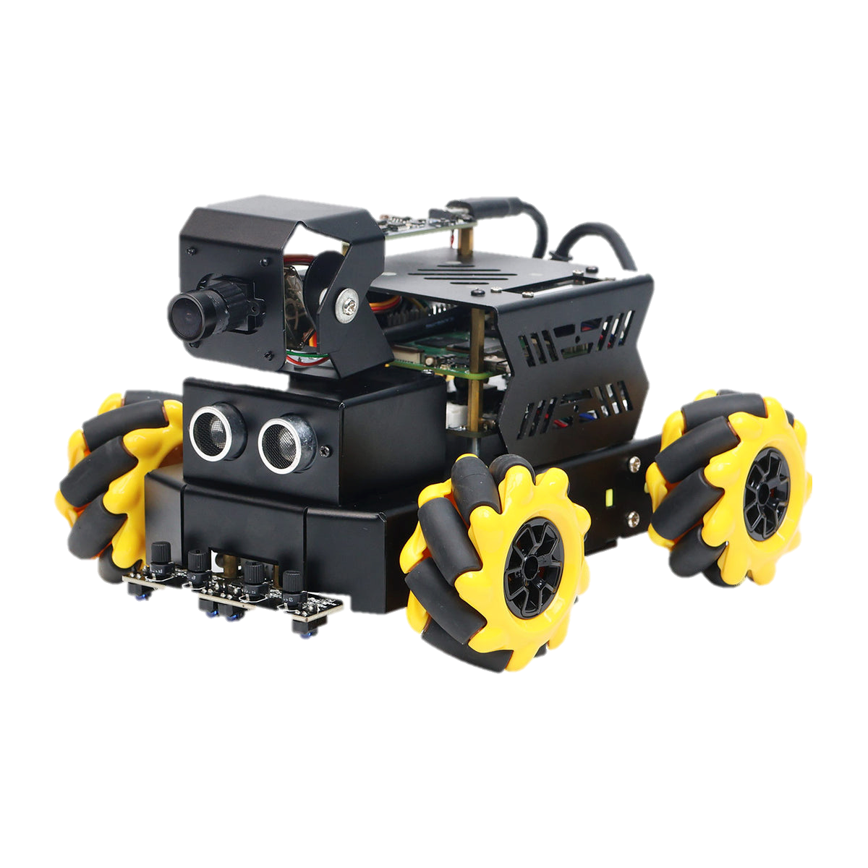
XXXXX
XXXXX XX X XXXX XXXX XXXX XX XXXX XXXXXXXX XXX XXX XXXXXXX XX XXXX XXXXXX XXX XXXXXXXXX XX XXXXXXXXXX XXXXXX XXXXXXXXXX XXXXXX XXXX XXXX XXXXXX XXXX XXXXXXXXXX
XXXXXXX XXXX XXXXXXXXXXX X XXXXXX XXXX XXXX XXXXXXXXX XXXX XXXX XXXXXXXXX XXX XXXXXXXX XXX XXX XX XXXXXXX XXX XXXXXXXX
XX XX XXXXXXXXXXXXXXXXXXXX XX XXXXXXXXXXXXXXXXXXXX XX XXXXXXXXXXXXX

Slide 29
XXXXX XX
XXXXXXXXXX XXX XXX XXXXX XX XXX XXX X XXXX XXXX XXXXXXX XXX XXXX X XXXXXXXX XX XXX XXXXXXXXXXX
XX XXXX XXX X XXXXXXX XXX XXXX XXXXXXXX XXXXX XXX XXXXXXXX XXXX XXXXX XXX XX XXXXXXX XXXXXXXXX XX XXXXXXX XXXXXXXXX XX XXXXXXXXX XXXXXX XXXXXX XXXX XXXXXXXX XXXXXXXXX XXX XXXXXXX XXXXXXXXXXX XXX XX XXXXXX XXXX XXXXXXXXXX XXXXXXXXXX X XXXXXXXXXXXX XXXX XXX XXXXXX XXXX XXX XXXX XX XXXXXXXXX XXXXXXX X XXXXXX XXXXXXXXX XX XXXXXXXX XXXXX XXXXXXXX XX XXXX XXXX XXXX XXXXXXXXXX XXXXXXXXXXXXX
XX XX XXXXXXXXXXXXXXXXXXXXXXX
XX XX XXXXXX XXXXXXXXXXXX
XX XX XXXXXXXXXXXXXX

Slide 30
XXXXX XX
XXXXXXXXXX XXX XXX XXXXX XX XXX XXX X XXXX XXXX XXXXXXX XXX XXXX X XXXXXXXX XX XXX XXXXXXXXXXX
XX XXXX XXX X XXXXXXXX XX XXX XXXXXXX XX XX XXX XX XXXX XXXXXXX XXXXX X XXXXXXXXXXXX XX XXXXXXXX XXX XX XXX XXXXXXXX XX XXXXX XXXXXXX X XXXXXXXXX XXXXXXXX XXXX XXXXXX XXXXXXXX XXX XXXXXX XX XXXXXX XXXXXXXX XXXXX XXXXXXXXXXX XXXX XXXXX XXXX XXXXXXXX XXXXXX XXXXX XXXXXX XXX XXX XX XXXXXXXXX XX XXXXX XXXXXXXXXXXXXXXXXXXXXX XXXXXX XXX XXXXXXX XXX XXXXXXXXXXX XXXXXX XXXXXXXXXX XXXXXXX XXX XXXXXXX
XX XX XXXXXXXXXXXXXXXXXXXXXXX
XX XX XXXXXX XXXXXXXXXXXX
XX XX XXXXXXXXXXXXXX

Slide 31
XXXXXXXXX
XX XXXX XXX X XXXXXX XX XXXXXXXX XXXXXX XXXXXXXXX XXXXX XXXXXXXXX XXXXXXXX XXX XXXXXXX XXXXXXXX X XXXXXXXXXX XXXX XXXXXXXXXX XXX XXXXXXXXXX XXXXXXX X XXXXXX XXX XXXX XX XXXXXXXXXX XXXXXXXXXX XXXXXX XXXXX XXX XX XX XXX XXXX XXXXX
XX XXXX XXX XXXXX X XXXX XXXXXXX X XXXXXX XXX XXXXXXXXXXXX XXXXXXXXX XXXXX XXXXX X XXXXXXXX XXXX XX XXXXXXXX XXX XXXXXXXXXX XX XXX XXXXXXX XXXXXXXXX XXX XXX XXXXXXX XXXXXXXX XXXXXXX XXX XX XXXX XXXXXXXXX XXXXXXXXXXX X XXXXXX XXX XXX XXXXXX XX XXXXXX XXXXX XXXXXXXX XXX XX XX XXXXXXXXX XXXXXX XXXXXX XXXXXX XXXX XXXXXXXX X XXXX X XXXXX
XXXX XXXXXXXXXXXXXXX
XX XX XXXXXXXXXX XXXXXXXXXXXXX

Slide 32
XXX XXXXXXX
XXXX XXX XXXX
XXXXXXXXXXXXXX XXXX XXXXX XXXXX XXXXX XXXX XX

Slide 33
XXXX XX XXXX XXX XXXXX
XXXX XXX XXXX XX X XXXXX XXXXXXX XXXX XXXXXXX XX XXXXXXXXX XXXXXX XX XX XXX XX XXXXXXX XX XXXXXXXX XXXX XX XXXXXX XXXXXXXX XXXX XXXXXXX XXX XXX XXXXXXXXXX
XXXX XXXXX XXXX XXXXXXX XXXXXXX X XXXXXX XXXXXXXXXXXXX XXX XXXXXXXXXXX XXXXXXXX X XXX XXXXXXXX XXX X XXXXXXX XXXXXXX XXXXXXXX

Slide 34
XXXXXXXXXXXXX
XXXXX XXX X XXXXXXXXXXXXXXX XXXXXXX X XXXXXXXXXXXX XXXXX XXXX XXX XXXXX XX XXXXXXX XXXXXX XX XXX XXXXX XX XXX XXX XX XXXX XXXX XXXXXXXXXX XX XXXXX XXXXXXXXX XXXXXXX XX XXX XX XXXXX XXXX XXXXXXXXX XXXXX XXXXXXX XXXXXXXXXXXXX XXXXXX XXX XXXXX
XXXXX XXX X XXXX XXXX XXXXXXXXX XX XXXXXXX XXX XXXX XXX XXXXX XXXXX XXX XXX XXXXXX X XXXX XXXXX XXXX XXX XXXX XXXXXX XX XXXXXX XXXX XX XXX XXXXXXXXXXXX XXX XXX XX XXX XXXX XXXXXXXX XXXXX XXXX XXXXX XXXX XXXXXX XX XXXX XX XXXXXXX XXX XXX XXXXXXX XXXXXXXXX XX XXX XXXX XXX XXXX XXXXXXXXXX XXXXXX XXXX XXX XXXX XXX

Slide 35

XXXXXXXXXXX
XX XXXXXXX XXX XX XXXX XXXXXXXX XX XXXX XX XXX XX XXX XXXXXXX XXXXX X XXXX XXXX XXXX XXXXXXX XX XXXXXXX XXXXXXXXX XXX XXXXX XXXXXXXXXXXXX XXXX XXX XXXXX XXXXXXX XXX XXXXXXXXXXXX XXXXXXX XXXXXXXXX
XX XXXXXXX XX XXXX XXXXXXXX XXXXXXXXX XXXX XXXXXXXX XX XX XXXXXXX XXX XX XXXXXXXX XXX XXXXX XXXXXXXXXXX XX XXXXXXX XXXX XXXXX XX XXXXX XXXXX XXXX XXXXXX XXXXXXXXX XXXXXXX XXX XXXXXXXXX

Slide 36
XXXXXX
XX XXXXX XXXXXX XXXXXXXX XXX XX XXX XX XXXXXX XX X XXXX XXXXX XXXX XXXXXXXXX XXXXXXXX XX XXXX XXXX XXX X XXXXXX XXX XXX XXX XXXXXXX XX XXXXXX XXXXXX XXX XXXXXXXXXX XXXXXXXXX XXXXX XXXXX XXXXXXXX XXX XXXX XXXXXX XXX XXXXXX XX XXXX XXXXXXXXX
XX XXX XXXX XXXXXXX XXXX XXXXXXX XX XXXXXXXXXX XXXXXXX XXXXXXX XXXXXXX XXXXX XXX XXXXX XXXXXXXX XX XXXXXXXXX XXXXXXXXX X XXXXXX XXXXXXXXXXXXXXXXXXXXXXXXX XXXX XXX X XXXXXXX XXXX XXX XXXXX

Slide 37
XXXXXXXXXXXXX
XXX XXXX XXXXXXX XXXX XXXXXXXXXXXX XXXXXXX XXXXXXXXX
XX XXXXXXXX XX XXXX XXXXXXX XXX XXXXXXXXX X XXXXXXXXXX XXX XXXXXXX XXXX XXXX XXXXXXXX XX XXXX XXXXXXXXXXXX XXXXXXXX XXX XXX XXXXXXXX XX XXXXXXXX XXXXX XX XXX XX XXXXXXX XXXXXXXX XXXXXXXXX
XX XX XXXXXXXXXXX X XXXX XXXXXXXX XX XXXXXXXXXXX XXXXXXXXX XXX XXXXXXXXXXXXX XXXXXX XXXXXXX XXXXXXXXXX XXXXXXXX XXXXXXXX XXXX XXXXXX XXXXXXXX XX XXXXXXXXXX XXXXXX XXXXXXX XXXXXXXXXXXXX XXXXXXXX XXX XXXXXXX XXX XXXXXXXXX XX XXX XXXXXX

Slide 38
XXX XXXX

Slide 39


Slide 43
XXXXXX XXX XXXXXXXXX

Slide 44
XXXXXX XXX XXXXXXXXX

